Slide 1
Update to TAS Acquisition Software
Robert Godin
26 Nov 2015

Slide 2
Software Versions
Original version taken as ‘Measure 2 channels_v6.vi’
Working version for any TAS system that has a scope (DPO3012, DPO2012B, TDS3012C) and a DAQ card (NI-6211, NI-6251) is called ‘RG TAS Software V*’
As of November 25th 2015, the version number is 2b

Slide 3
Interface

Slide 4
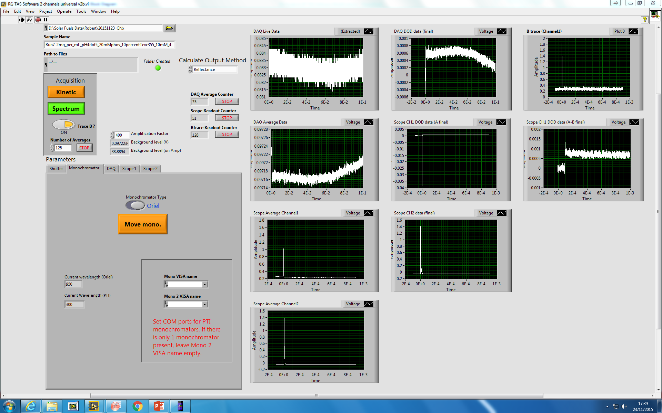
1
2
3
4
5
6
7

Slide 5
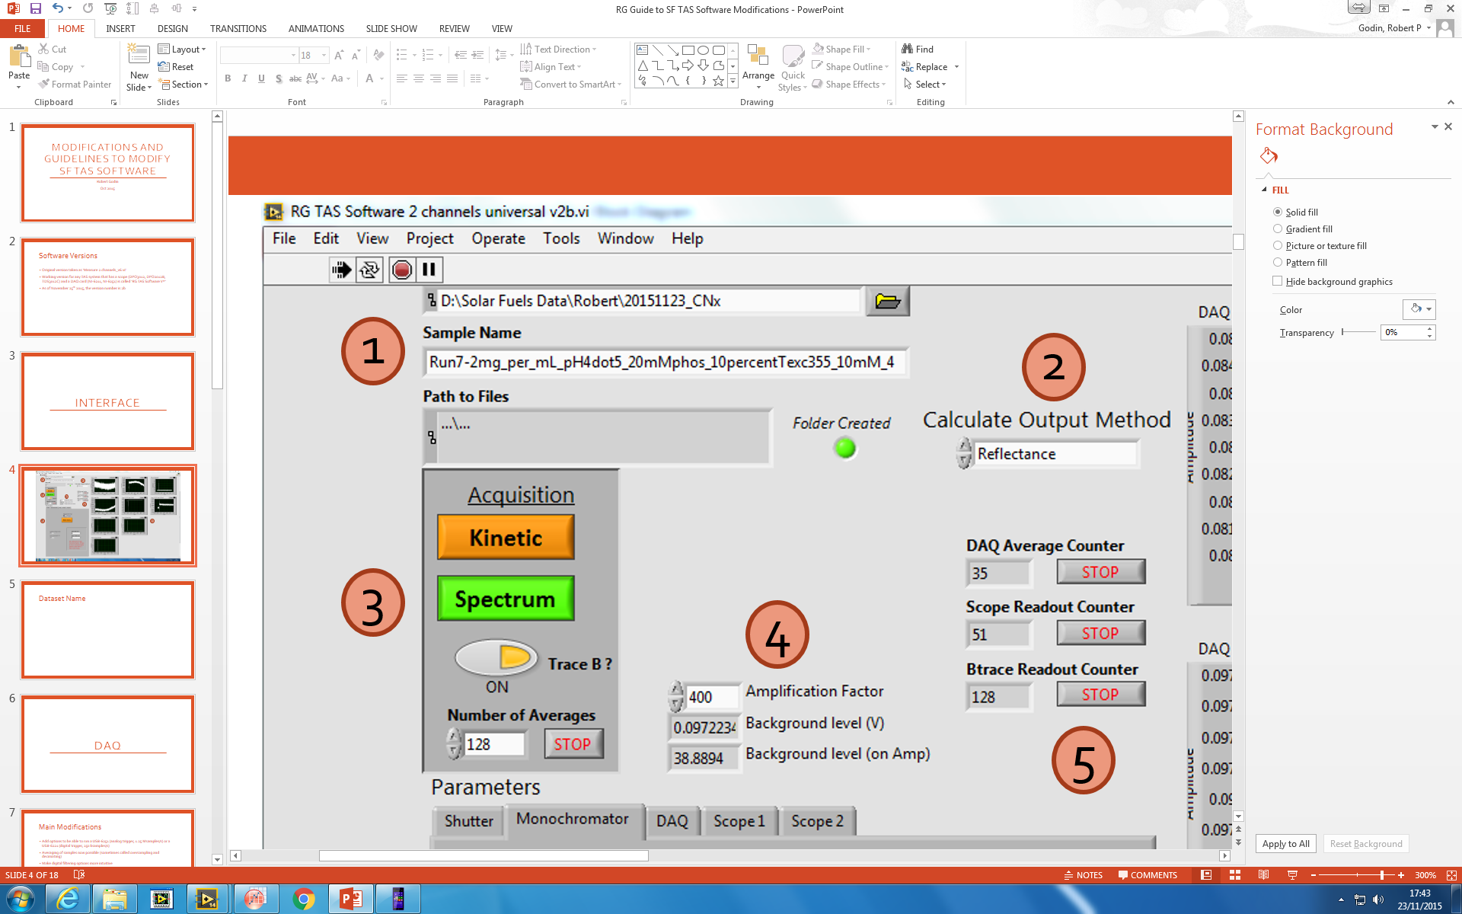
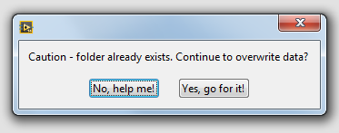
1. Dataset Name
* Note that program should be constantly running (black arrow, stop sign visible)! This is different than before where clicking on the white arrow to run the program would start the program, run the acquisition, and then the program would exit
If you try to start an acquisition to a folder that’s already there, the program will warn you that you might overwrite data and gives you a chance to abort the run (which will stop the program)

Slide 6
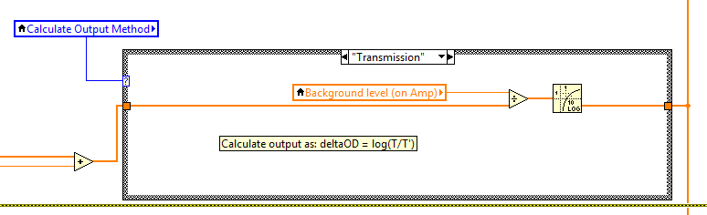
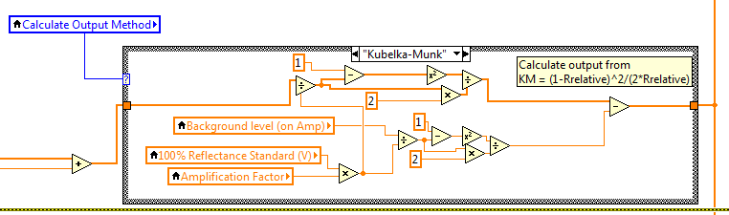
2. Output Method
Choose between Transmission, Reflectance, and Kubelka-Munk as your output
Transmission: ∆OD = log(T₀/T_{t})
Reflectance: Transient absorbance = 1 – R_{t} = (R₀ – R_{t}) / R_{0.}
Kubelka-Munk: KM, F(R) = K/S = (1 – R_{rel})^2 / (2 x R_{rel}), where R_{rel} = R / R_{100%}
For diffuse reflectance measurements, reflectance is appropriate when transient concentration is exponentially decreasing from surface, and KM is appropriate for ‘plug’ of constant concentration of transients over a distance
Rule of thumb:
Reflectance ok to use when amplitude of signal is affected by changes in excitation power
Otherwise, use KM (do BaSO₄ standard!)

Slide 7
3. Acquisition Options
Acquire a single trace (Kinetic) or multiple traces at different wavelengths (Spectrum)
Toggle On/Off acquisition of B trace (background trace)
Select number of shots to average
Button will be green while it is busy, and a popup message will appear once the acquisition is complete (also applies to shutter and monochromator moves)

Slide 8
4. Background Levels
Amplification factor will slightly vary between different amplifiers (should be within 2% of 400), and should be set for each setup
Can check the value by measuring a constant signal and taking the ratio of the background level displayed on the amplifier and the voltage measured by the DAQ
Background level (V) is what is measured by DAQ , while Background level (on Amp) is calculated from Background level (V) x Amplification Factor
Compare to what is displayed, values should be close to each other

Slide 9
5. Shot Counters
Counts number of transients that have been passed to the computer
Clicking STOP will cause program to exit acquisition loop for the DAQ or scope and move to the next step

Slide 10
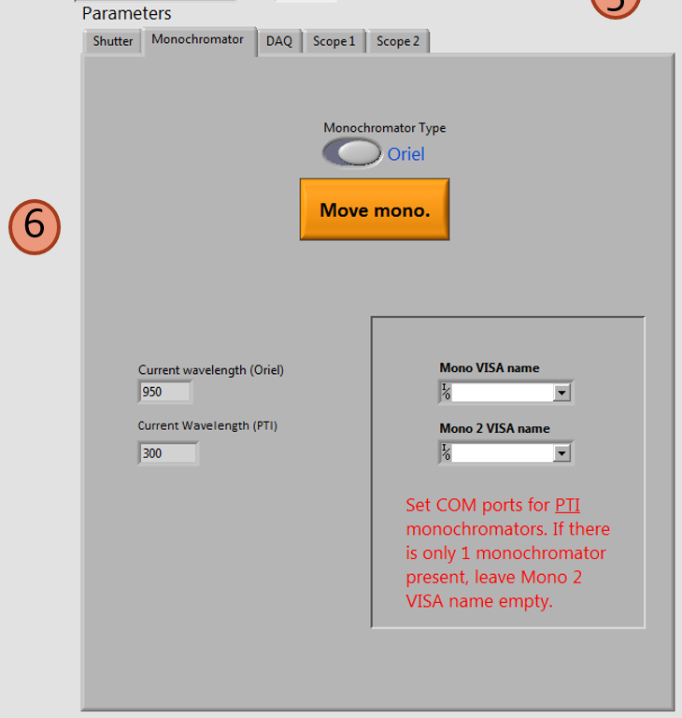
6. Parameters Tabs
Configure settings of instruments that are computer-controlled
Will explain each tab in later slides

Slide 11
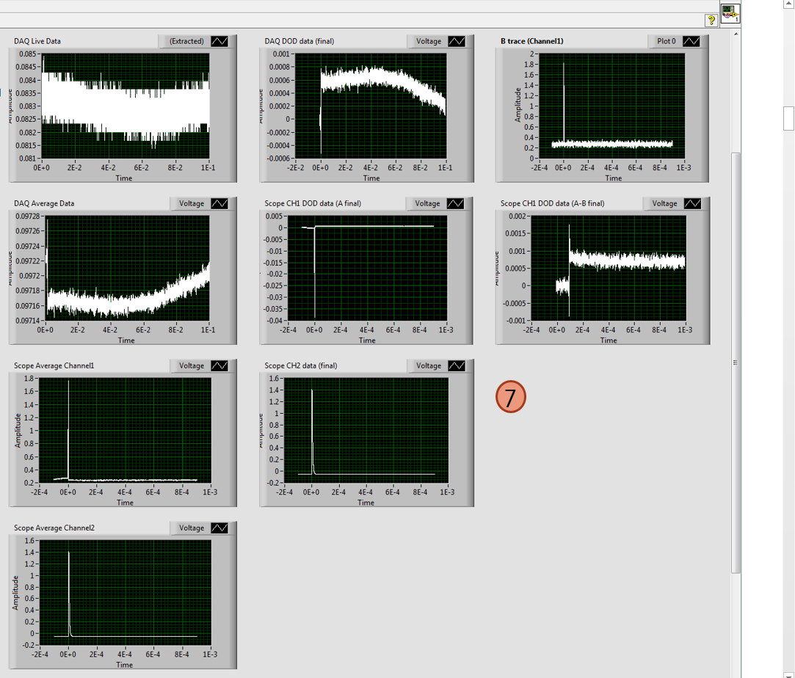
7. Data Graphs
Pretty self-explanatory

Slide 12
Shutter

Slide 13
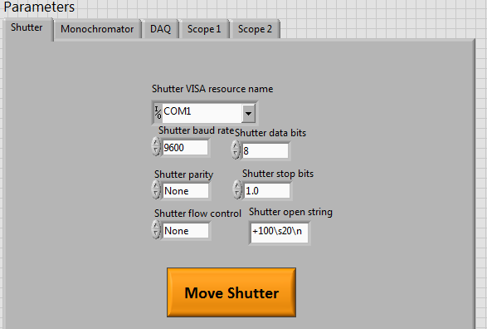
Main Modification
Can now move it without starting an acquisition
Control how far the shutter moves by changing the number ‘+100’ in the shutter open string.
Larger number = more rotation
+ and – dictate the handedness of rotation

Slide 14
Monochromator

Slide 15
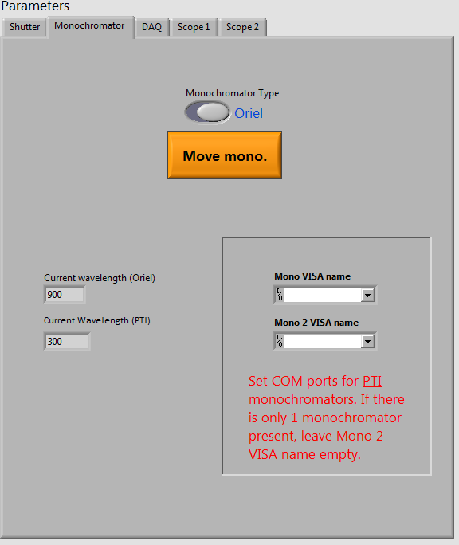
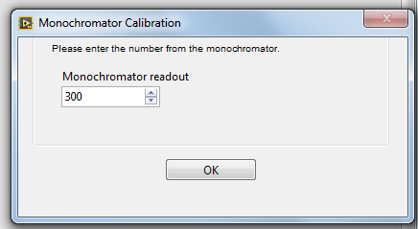
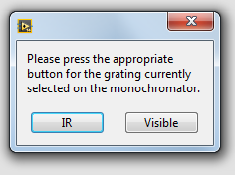
Main Modifications
Added the functionality!
Choose between Oriel (on the DR) or PTI (all other setups)
If using PTI, also indicate the address of the monochromator(s)
If no monochromator is controlled by the computer, choose PTI and leave VISA names blank. Enter the wavelength you are monitoring and click ‘Visible’ grating (IR will give current wavelength = 2 x inputted wavelength)
Note that the current wavelength information is added to the beginning of the file names

Slide 16
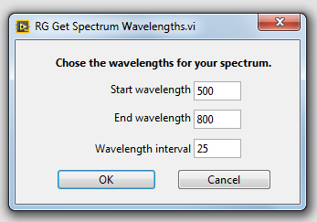
Spectrum Acquisition
As the monochromators can be computer controlled, now the software can also do spectrum acquisition
Repeat the same acquisition at many different wavelengths
To acquire a spectrum, click ‘Spectrum’
Enter desired wavelengths
If using PTI, there will be a pause to let you manually change the grating (automatic with the Oriel)

Slide 17
DAQ

Slide 18
Main Modifications
Add options to be able to run a USB-6251 (analog trigger, 1.25 Msamples/s) or a USB-6221 (digital trigger, 250 ksamples/s)
Averaging of samples now possible (sometimes called oversampling and decimating)
Make digital filtering options more intuitive
DAQ acquisition now has a constant 1% of points as the pretrigger, and calculates the background level from the earliest 75% of these pretrigger points (0.75% of total points)

Slide 19
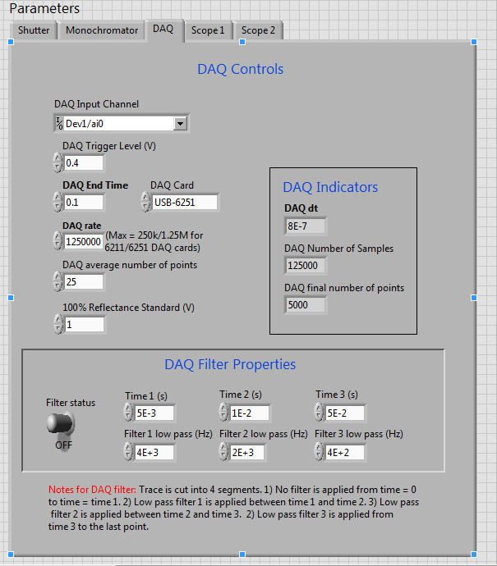
DAQ Settings
Choose the device and input channel of your DAQ card from the dropdown menu(typically Dev1/ai0 or Dev2/ai0)
For USB-6251 only, chose the trigger level
*USB-6221 only accepts digital triggers, for which the signal should be > 2V to reliably trigger
Length of DAQ acquisition
Sampling rate of DAQ cards (should be kept to max)
How many samples are averaged together to make 1 outputted data point (final time between data points will be DAQ dt x DAQ avg number of points)
1
2
8
7
3
4
5
6
9

Slide 20
DAQ Settings
Voltage of background light from a standard as measured by the DAQ. Use BaSO4 as a 98% standard
* Only used in Kubelka-Munk analyses
Choose the DAQ card on your system (controls trigger settings in RG DAQ with trigger.vi sub vi)
Showing calculated values of a few parameters
Digital filtering. Toggle on and off with switch, change parameters. Low pass frequencies must be higher than 2 times the original sampling rate
1
2
8
7
3
4
5
6
9

Slide 21
Scope

Slide 22
Main Modifications
Add options so that different scope models (DPO3012, DPO2012B, TDS3012C) can be used by same software
Take advantage of better scope capabilities by either using HiRes mode or oversampling (taking 1 M points for example)

Slide 23
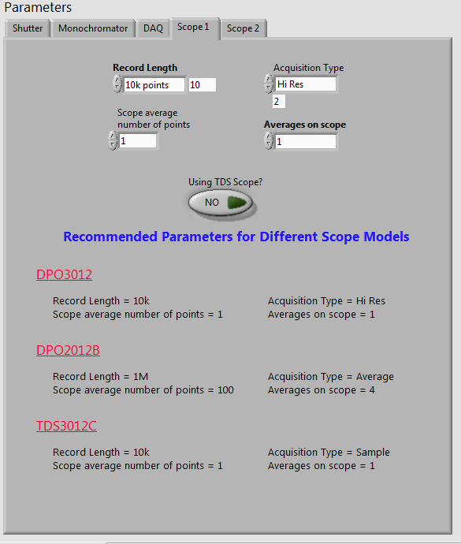
Scope 1 Settings
Number of data points the scope acquires
How many data points to average together (ex. DPO2012B, acquire 1M points, average 100 together = 10k points final output).
Acquisition mode (Sample, Envelope, Hi Res, Average)
Only set other than 1 if you choose average as acquisition mode (in this case, how many acquisitions to average on the scope before transfer to computer)
Toggle on if using TDS model scope (changes some of the programming commands used)
1
3
2
4
5

Slide 24
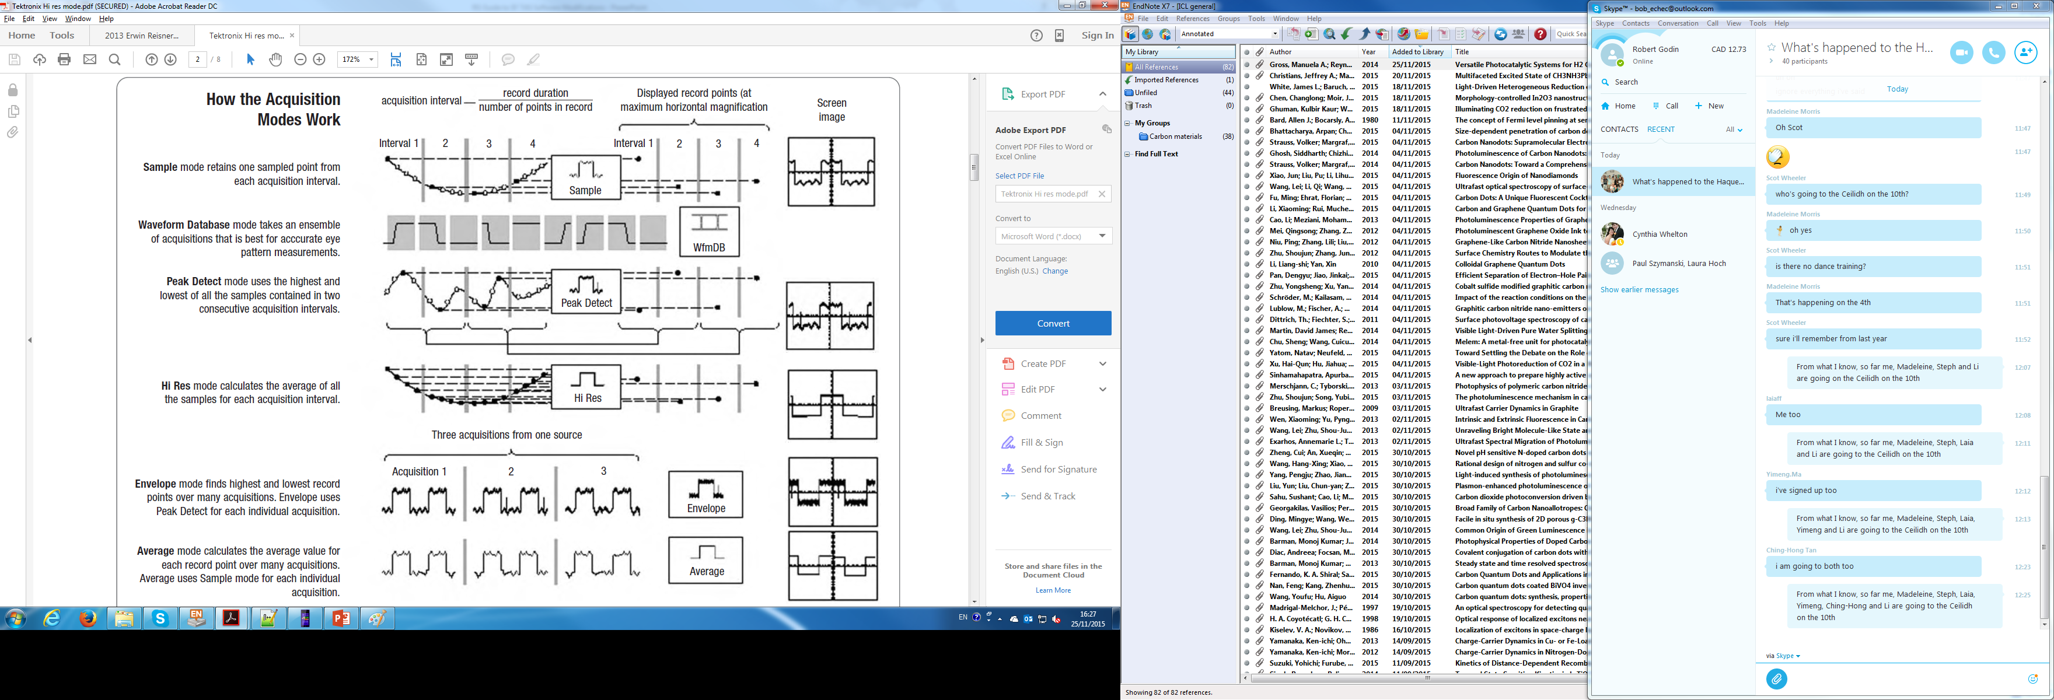

Slide 25
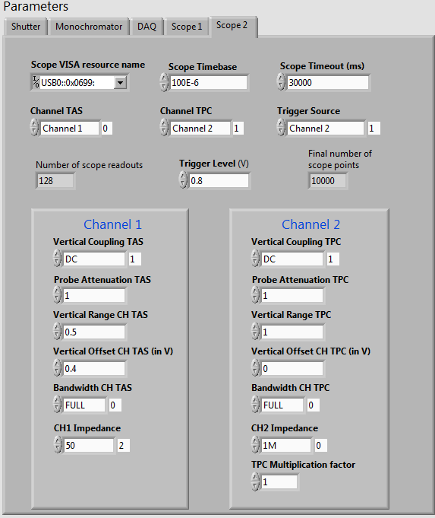
Scope 2 Settings
2
1
3
Address of scope
Time per division on scope X axis
Maximum amount of time the scope will wait to finish an operation before an error occurs
Optical data channel
Electrical data channel
Trigger channel
Indicates how many times data will transfer from scope to computer (= number of averages/averages on scope)
4
5
6
7
8
9
10
11
12
13
14
15
16

Slide 26
Scope 2 Settings
2
1
3
Trigger level on trigger channel
Indicates the number of outputted data points (= record length / scope average number of points)
Electrical coupling. Keep at DC.
Probe attenuation. Change only if using probes that require this.
Volts per division on scope Y axis
Adjust to centre trace on scope
Rejects signals faster than bandwidth (lowpass filter)
4
5
6
7
8
9
10
11
12
13
14
15
16

Slide 27
Scope 2 Settings
2
1
3
Impedance of scope channel.
Our optical detectors require a 50 ohms impedance at the far output. This means that CH1 impedance should be set to 50 (ohms). DPO2012B can only do 1M ohms, and so use a T with a 50 ohm terminator.
Really the photodiodes we use to get the trigger signal should want 50 ohms impedance at the end, but since the DAQ impedance is high, it should be kept at 1M ohms. If set to 50, the DAQ will not see any change in voltage
Multiplication factor to scale and convert data.
4
5
6
7
8
9
10
11
12
13
14
15
16

Slide 28
Diffuse Reflectance

Slide 29
Laser excitation pulse
Detector
Probe light
Transmitted light
Reflected laser
Diffuse Reflection
Detector

Slide 30
Samples Appropriate for DR
Whenever you don’t have enough transmitted light to get a signal
Scattering films or solutions
Opaque layers (i.e. Au electrodes)
Whenever the penetration depth of your excitation is too small to get a signal (i.e. very high absorbance at excitation wavelength)

